Slide 2
Summary

Slide 3
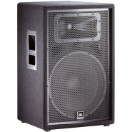

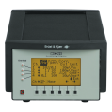
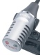
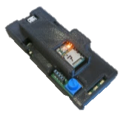
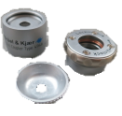
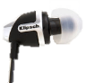
Speaker
Room Mic
DAQ
Coupler Mic
Mic
Electronics (w/SD)
Earbud
2cc Coupler
Tympan

Slide 4
Speaker
Room Mic
DAQ
Mic
Electronics (w/SD)
Tympan

Slide 5
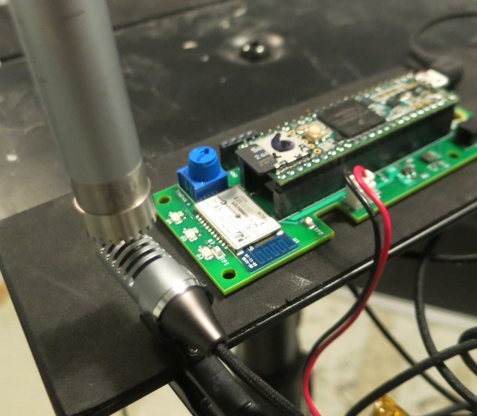
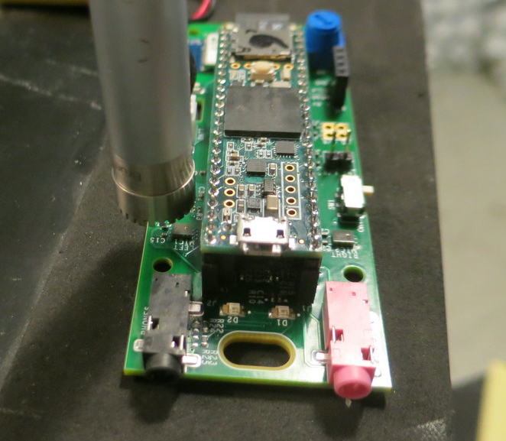
“Truth”
Mic
“Truth”
Mic
PCB
Mic
Sony
Mic

Slide 6
PCB Mic - Calibration

Slide 7
PCB Mic – Noise Floor (Input)

Slide 8
Sony Mic

Slide 9
Sony Mic – Noise Floor (Input)

Slide 10
Knowles Mic - Calibration

Slide 11
Knowles Mic – Noise Floor (Input)

Slide 12
Input Summary

Slide 14
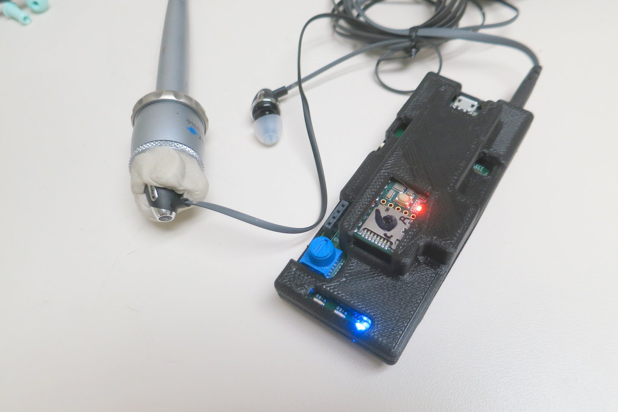
Calibrating Output
Tympan
Instrumentation
Electronics
Earbud
2cc Coupler
Mic
DAQ

Slide 15
Calibrating Output

Slide 16
Max Output

Slide 17
Alternate Output Cal (PCB Mic)

Slide 18
Alternate Output Cal (Sony Mic)

Slide 19
Alternate Output Cal – Knowles Mic

Slide 21
Output Self-Noise Noise Floor

Slide 22
End-to-End Calibration

Slide 23
PCB Mic -> Klipsch Earphones

Slide 24
Sony Mic -> Klipsch

Slide 25
Knowles Mic -> Klipsch

Slide 26
End-to-End Noise Floor

Slide 27
Noise Floor: PCB Mic -> Klipsch

Slide 28
Noise Floor: Sony Mic -> Klipsch

Slide 29
Noise Floor: Knowles Mic -> Klipsch

Slide 30
End-to-End Noise Floor Summary

